Slide 1


Software Requirement Engineering & Product Management
Boat Dock App

Slide 2


Group # 4
Muhammad Mohsin Qamar Khan
Syed Ali Hasan
Muawaz Ayyaz
Sai Prakash Chakla
Muhammad Shahzaib
Hafiz Muhammad Sultan Afridi

Slide 3

Agenda
Introduction
Proposal
Product requirement
Elicitation and technique
Requirement Specification technique
Requirement Prioritization
Release Planning
Learning objective with RE course
Q & A
End

Slide 4
Introduction
The proposed Boat Dock App management system will provide customer and moor owner to publish advertisement and moor dock place for customer.
The user need to publish Add, search advertisement, browsing the moor catalogue and ability to complete mooring hiring online with payment system.

Slide 5
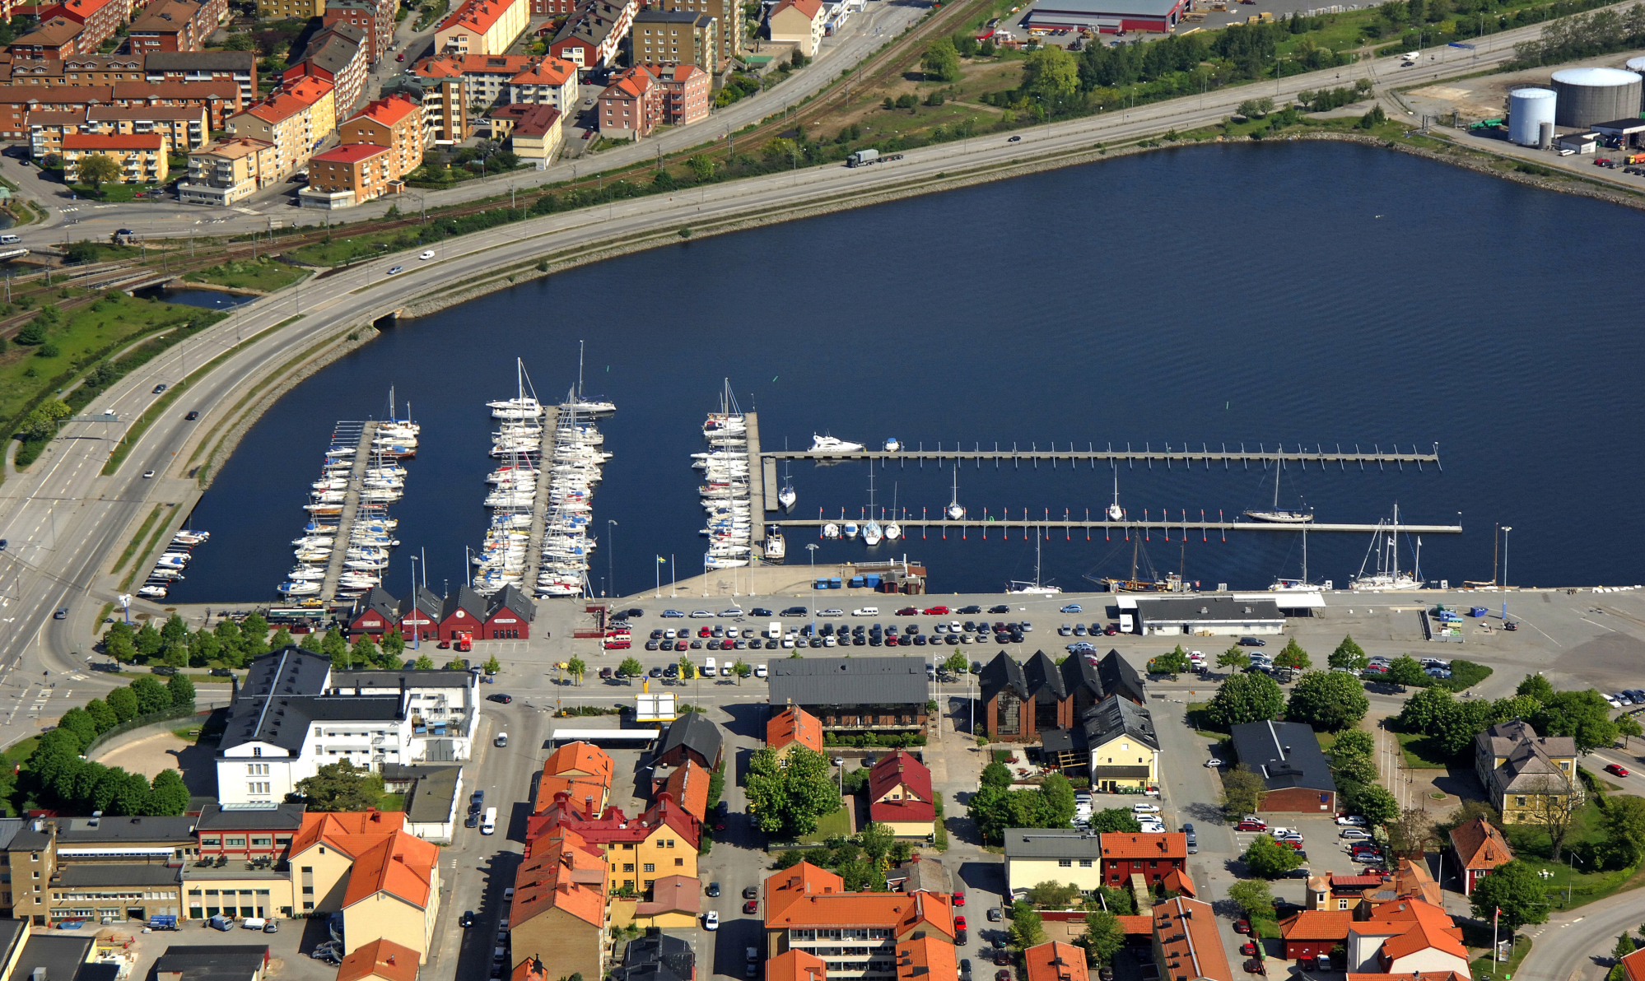
Karlskrona Boat Docking Sites

Slide 6
Scope
This system is an interactive web based system that support the marketing of location based Boat mooring and hospitality industry of Sweden and Nordic region.
The system support directly redirect customer to mooring dock and its existing company sales agent network.

Slide 7
Functionality of Boat Mooring App
Possibilities to registration boat with length, width, height.
Search for the area for moor and must be specified price, distance time date and length, width and depth if not registered.
Show available alternatives that are compatible with boat.
Information about the mooring price ,distance, revenue.
Costumer option to review the experience with rating.
In App Payment via various gateways.
System should be secure with login with two factor authentication(OTP via SMS/ Email).
Chat Option between Mooring Owner and customer .

Slide 8
Specification for the BoatDockApp.
Stakeholder Identification and analysis: we lists the client for development the system. List of all stockholders and the group of interest of importance.
Requirements Elicitation Techniques: we lists the requirement elicitation techniques that you used and brief summary of particular technique.
System Requirement: here requirement at different levels domain and product design with data functional and quality in each level.

Slide 9
Goals of Boat Dock App
The system shall allow for online rent a mooring place either by customer or sales agent moor owner. This will eliminate the current delay between their decision to customer and the location owner this will reduce the time.
Mooring place detail and description update within 30 seconds of the database being
updated by the product owner. This will reduce the number incorrect location with Google Map API and this will also eliminates the redundant update of customer information.
The system shall display all information of location, mooring place and price and other facilities associated with company. This feature will improve service by reducing the mean number of web pages a user must navigate per session to 10000 / user.
The system allows ABC Company to view all owner of moor location. An customer / moor owner should able to contact to ABC company in one call/email to save time for correct any information.
The system should provide accounting with actual amount of transaction. This will improve the customer service reducing billing complain by 100% in correcting inaccurate account. Reports facilities provide for future uses.
The system provides accurate location and places and agreement details so this will allow the order to be processed in intently and details updated within 10 seconds

Slide 10
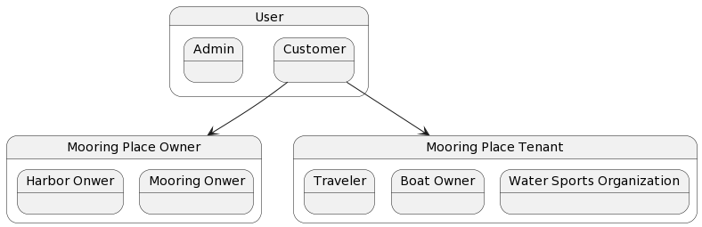
Stakeholder Identification & Analysis

Slide 11

Requirements Elicitation
Elicitation Technique 1 (Observations):
Elicitation Technique 2 (Interview):
Elicitation Technique 3 (Brainstorming):
Elicitation Technique 4 (Reverse brainstorming):

Slide 12

Elicitation Technique 1: Observations
Understand the initial proposal of the system and through inspection observed the system
Made a general user standing of the system before conducting first interview

Slide 13

Elicitation Technique 2: Interview
Interview 1
Elicit initial requirements
Understanding the business flow of the system
Discussion about main features
Interview 2
Feedback about our SRS
Discussion about functional and non-functional Requirements
Discussion about prioritization and release planning

Slide 14

Elicitation Technique 3: Brainstorming
Conducted the interview and refined the requirements and process.
Discussion about the problems we could face in application (3rd party integrations)
Understand the possible solutions we could use in the application

Slide 15

Elicitation Technique 4: Reverse BrainStorming
Conducted the interview and refined the requirements and process.
Discussion about the problems we could face in application (3rd party integrations)
Understand the possible solutions we could use in the application

Slide 16
Requirement Specification
Requirement Specification:
Domain level Requirements
Data Requirements
Functional Product level Requirements
Quality Requirements
Techniques Used:
Screens and Prototypes(Functional product level requirements)
Task descriptions (Functional product level requirements)
Use cases (Functional product level requirements)
ERD Model (Data requirements)
Data Dictionary ( Data Requirements)
QUPER Model (Quality Requirements)

Slide 17
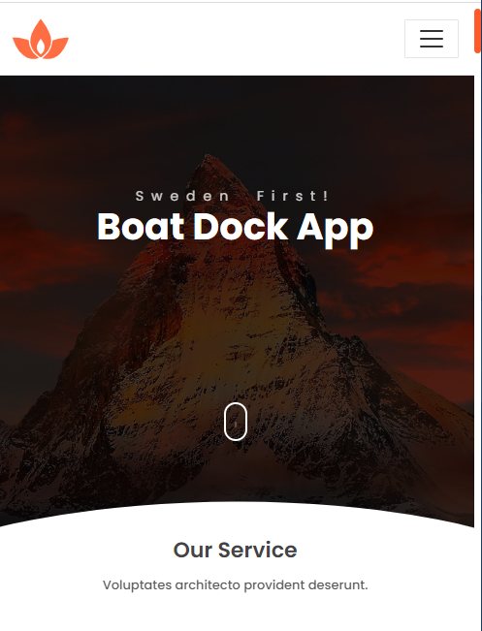
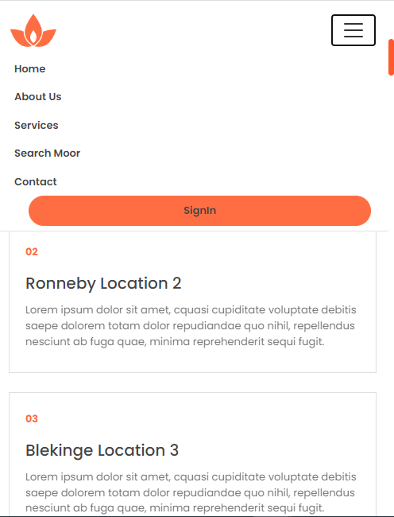
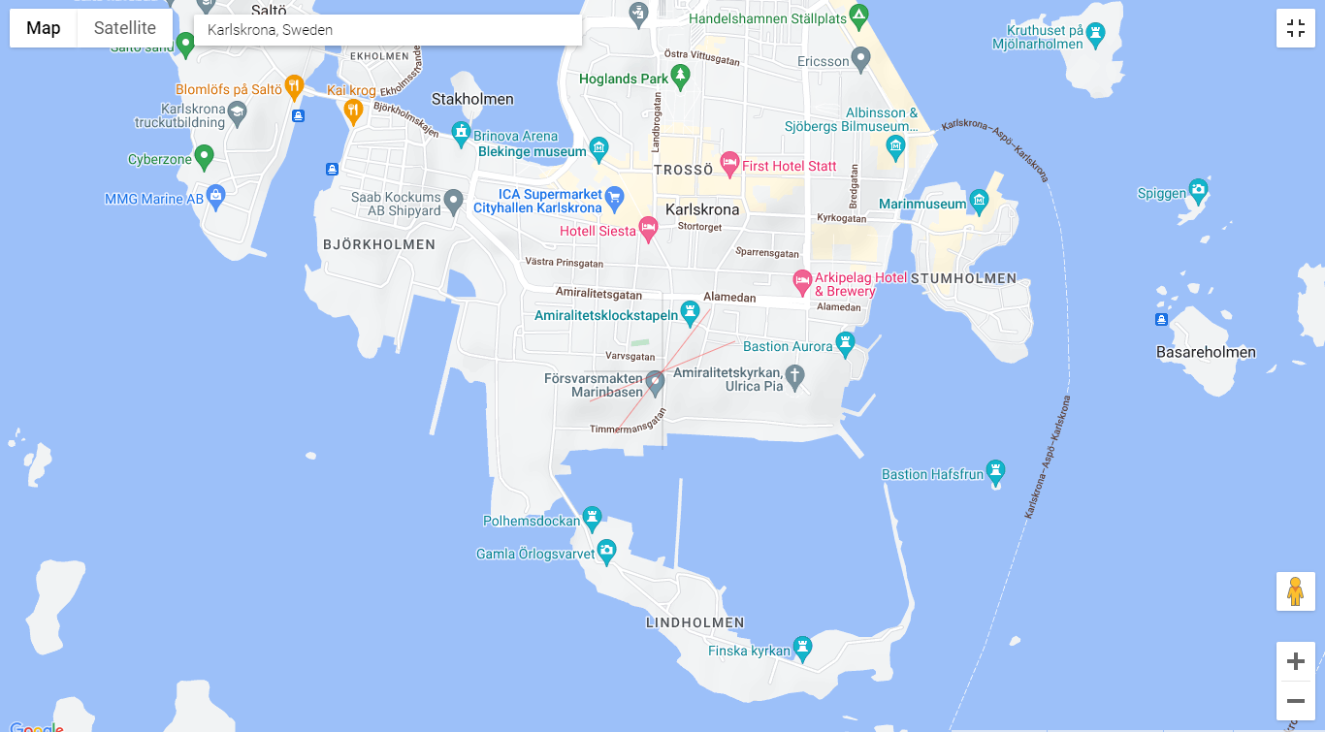
BoatDockApp Mocks (Prototype) Responsive Design

Slide 18
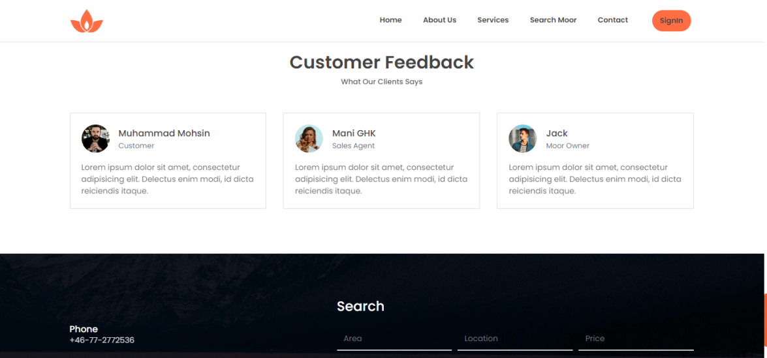
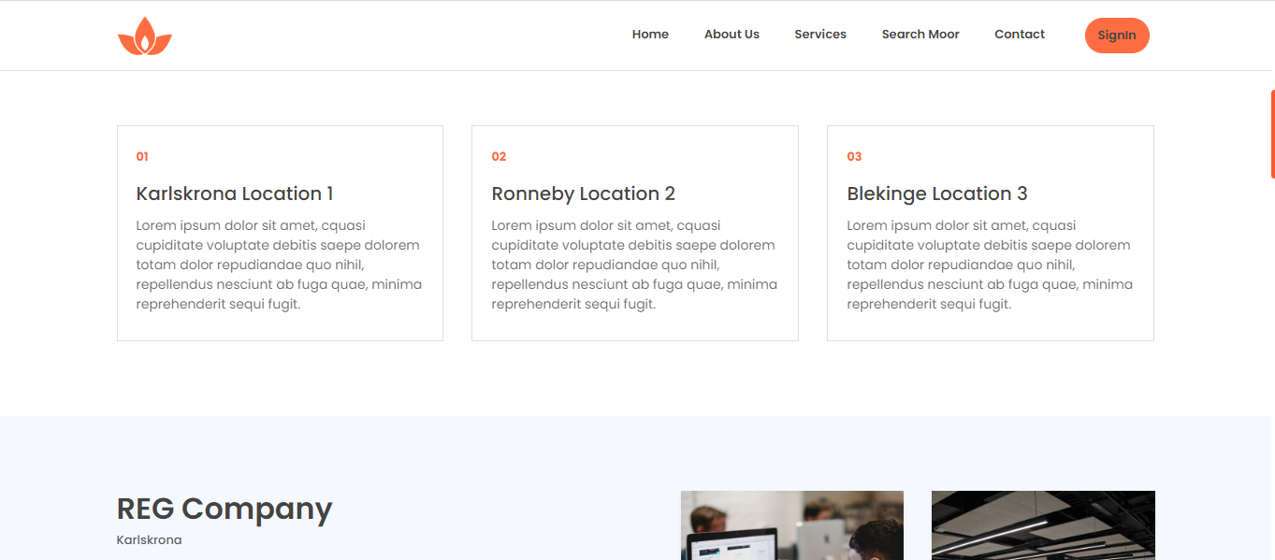
BoatDockApp Mocks (Prototype)

Slide 19
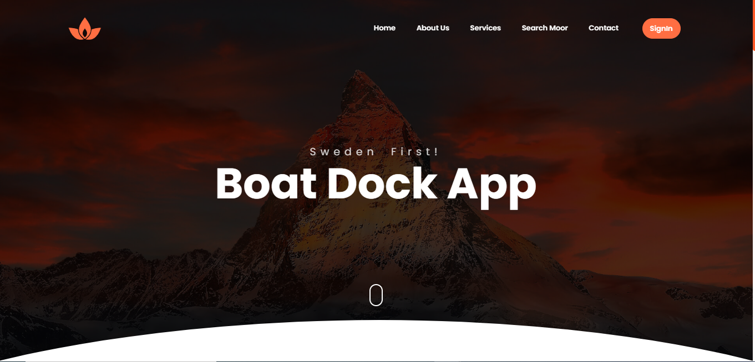
BoatDockApp Mocks (Prototype)

Slide 20
Task Descriptions
Task Name: 1.1 Registration
Purpose: Registered customer to Mooring App Trigger: Precondition: customer looks to mooring boats and registered first Frequency: 0.6 customers / minute (customer use the application) Critical: user already exsist/ user block /account marked suspecious
Sub-tasks: Registered to application Gives personal information Geographical information
Variants: User already exsist False information Authentication not confirm

Slide 21
Use Cases
Use Case Name | 1.1 Customer Registration
Brief Description | Customer/user registered to applicaiton / login to App
Actors | Customer/ Moor Owner/ client
Precondition | User need user id and password to access the App
Basic flow | 1)Customer download the applicaton 2) Customer registered to application by providing user email / password 3) Cusotmer recieved confirm
Alternative flow | 1)Customer call to Support 2)provide information and registered.
Exit conditions | Logout from application

Slide 22
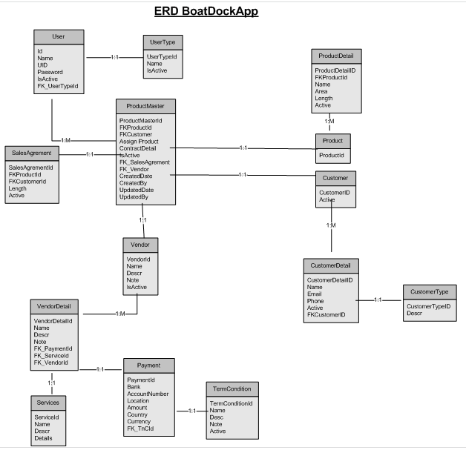
Entity Relationship Diagram

Slide 23
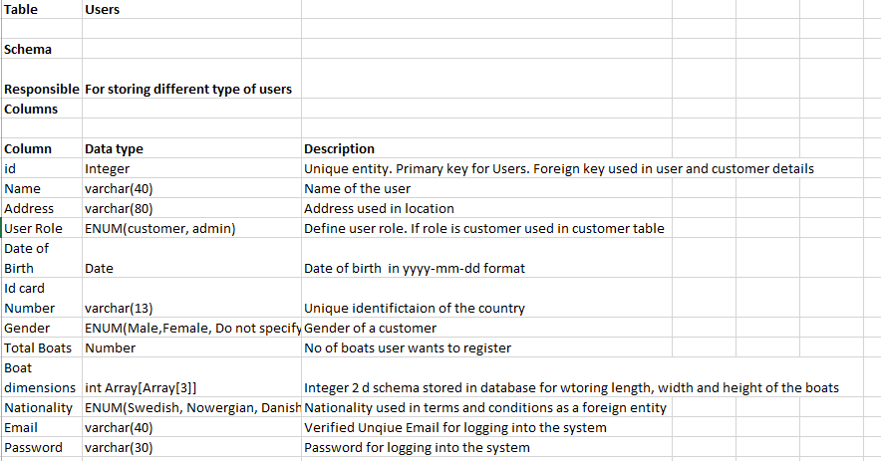
Data Dictionary

Slide 24
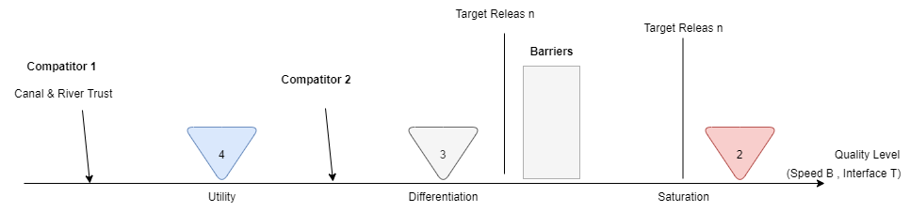
QUPER Model
Creation:
Quality Aspect:
Performance: System response time for each page (5 Sec)
Reference list/ competitors
Canal & River Trust: (Take 2 sec)
Quality Break points
Utility: 4 Sec: All page load time
Differentiation: 3Sec : Filtration activate
Saturation: 2sec: Mooring Place booked
Barriers
Steep cost: 5 sec: payment system
Steep Cost: 3 sec: new architecture
Target
Good: 3 Sec: This target is possible to create an own payment system without using third party service.
Stretch: 3 Sec: If new S/w Architecture is feasible.

Slide 25
Requirement Prioritization
We used 2 techniques for requirement prioritization
MoSCow technique
Priority Group
We have stakeholder which requirement are prioritized
Mooring place owner
Travelers/boat owner

Slide 26
MoSCow Technique
Must Have
Mooring place owner must have functionality to:
View the requests of tenants for mooring place
Chat with the applied tenants for the mooring place
View and give mooring place to applied tenant
Traveler, boat owner must have functionality to:
Search the mooring places using keywords in search words
Search the mooring places by getting the current location
Apply to rental mooring place
Able to register the into the system
Should Have
Mooring place owner must have the functionality to:
View the total revue generated by the application
View the profile of the applied tenant
Traveler, boat owner should have the functionality to:
View the previous rating of the place

Slide 27
MoSCow Technique (Contd.)
Could Have
Traveler, boat owner should have the functionality to:
View the previous rating of the mooring place
View restaurants and hotel near the mooring place
System Admin, ABC Company should have the functionality to:
View the total number of registered users in the system
View the user by categories (tenant, mooring place owner)
Login into the system
Modify ads through admin dashboard in the system
Would have
System Admin, ABC Company should have the functionality:
Categorized users in by mooring owners and mooring place tenants
Traveler, boat owner should have the functionality to:
Rate the mooring place and services after the rental agreement is finished
Also interact the application through an mobile application
Set alerts of nearby newly opened restaurants
Set alerts of discount in nearby restaurants

Slide 28
Priority Group
Divide the requirements into High, Medium and Low
Important stakeholders requirements are added in High category

Slide 29
Priority Group
Priority Level | Requirement
High | Mooring place owner must have functionality to View the requests of tenants for mooring place Mooring place owner must have functionality to Chat with the applied tenants for the mooring place Mooring place owner must have functionality to Promote the mooring place by payment to the system Travelers/boat owners must have the functionality to Apply to rental mooring place Travelers/boat owners must have the functionality to Able to register the into the system
Medium | Mooring place owner must have the functionality to View the total revue generated by the application Mooring place owner must have the functionality to View the profile of the applied tenant Travelers/boat owners must have the functionality to Search the mooring places using keywords in search words Travelers/boat owners must have the functionality to Search the mooring places by getting the current location Traveler must be able to View the previous rating of the place System Admin, ABC Company should have the functionality to View the total number of registered users in the system System Admin, ABC Company should have the functionality to View the user by categories (tenant, mooring place owner) System Admin, ABC Company should have the functionality to Login into the system System Admin, ABC Company should have the functionality to Modify ads through admin dashboard in the system
Low | View the user by categories (tenant, mooring place owner) Login into the system Modify ads through admin dashboard in the system Traveler, boat owner should have the functionality to Rate the mooring place and services after the rental agreement is finished Traveler, boat owner should have the functionality to Also interact the application through an mobile application Traveler, boat owner should have the ability to Set alerts of nearby newly opened restaurants Traveler, boat owner should have the ability to Set alerts of discount in nearby restaurants
High, Medium, Low

Slide 30
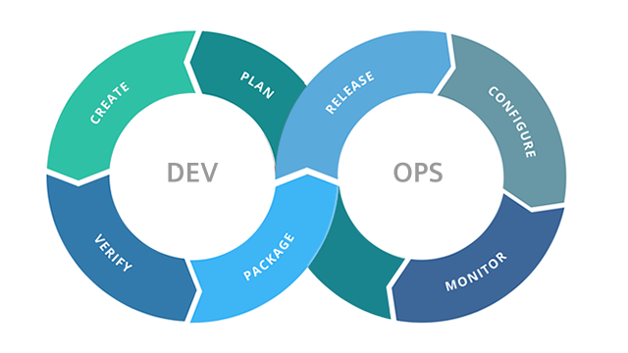
Release Planning (Agile)
Divided our product into 4 sprints
Deliver requirements of important stakeholders in the early sprints
SIT Planning
Integration of the connecting with Bank API, outer systems
UAT testing
First release plan (TDD approach)
After getting feedback, we move into production

Slide 31
Learning Outcomes
Plan how to gather requirements from the stakeholders
Learned about the requirement engineering standards
Learned how to interact with customers and elicit and get feedback from them
Grow our technical knowledge to design a product
Learn to prioritize the requirements basis on which parameters
Handle customer expectations and product management and finance negotiations

Slide 32

Questions and Feedback

Slide 33


